Slide 1
NEW HORIZONS REHABILITATION SERVICES, INC
SAFE WORK GUIDELINE PLAYBOOK
A guide for COVID-19 Pandemic
Preparedness and Response and general safety procedures
TO ALL READERS
The information contained in the Safe Work Guideline represents New Horizons practices regarding the recommended operation of its facilities, during the time of COVID-19 pandemic and beyond.
The health and safety of Staff, Hourly, Persons Served, Visitors and Contractors is our number one priority.
Changes have been updated based latest CDC recommendations.
All other health and safety rules and regulations are located in SharePoint, section 10 of policy forms.
Version 9.0 MAR 17, 2022

Slide 2
DISCLAIMER
Please note that this is a “living” document that may be updated at any time by New Horizons Rehabilitation Services, Inc given the fluidity of this or any given situation.
New Horizons Rehabilitation Services, Inc. bears no responsibility for any circumstances arising out of or related to the adoption, or decision not to adopt, any of the practices or procedures contained in the New Horizons Rehabilitation Services Safe Work Guideline
Questions can be emailed to​ COVID19@newhorizonsrehab.org
General Safety guidelines – See Section 10
https://newhorizonsrehab.sharepoint.com/Policies/Forms/AllItems.aspx

Slide 3


NEW HORIZONS REHABILITATION SERVICES, INC.
Our Mission Statement
Investing in our communities by providing employment opportunities for individuals facing barriers to employment.
Our Values
• We believe in the worth of all individuals.
• We believe that the people we serve are our most important customers.
• We believe in the dedication to individual growth, employment, and self-sufficiency.
• We believe in managing public and private funds efficiently and responsibly.
• We believe our staff is professional, committed, and caring.
• We believe in quality service; as measured by outcomes, is paramount.

Slide 4
New Horizons Rehabilitation Services, Inc is deeply focused on keeping our staff, hourly, persons served, suppliers, and visitors safe while in our facilities and out in the community.
As we continue to navigate this new normal, we have tapped into several resources, to develop a Safe Work Playbook.
While it is not a one-size-fits-all approach, the Safe Work Playbook include practical recommendations for COVID-19, based on current guidelines from the Center for Disease Control and Prevention, WHO, MIDHHS, and OCHD that could be tailored to address various scenarios that we may face when working and in the community.
This has been a difficult time for everyone and having a workplace where everyone feels comfortable performing their jobs safely is a multi-faceted challenge.
This Playbook covers a wide range of topics, including:
  Step-by-step guides for setting up a pandemic response team
  Cleaning and disinfection procedures
  Staggering drop off and pick up times, breaks and other distancing strategies.
  On-site health screening
  Protocols for isolating anyone who becomes ill at work
  Training will be provided (virtual or in-person) for all employees to be able to provide screening
  General safety
Notes:
*World Health Organization
*Michigan Department of Health and Human Services

Slide 5

COVID OPERATING PROTOCOLS
Site Entry Procedures:
  Prior to Arrival
  Upon Arrival
  Wash hands immediately after screening
Pandemic Response Team when needed
Preventative Materials Inventory
Personal Protection Equipment
Disinfection Measures
Deep-Cleaning and Disinfection Protocol
Staff make sure all Persons Served are adhering to the protocols
If you are sick – STAY HOME & call your doctor
Isolation Protocol & Coordinator Training
Social (physical) Distancing Protocol when recommended
On-Site Health Screening when needed
Daily Self-Screening Protocol
Quarantining and Return to Work Protocol
Visitors and Contactors Screening
Labor Alignment
Audit checklist
Transportation

Slide 6
OTHER OPERATING PROTOCOLS
Other operating safety protocols are outline in SharePoint Section 10 Health and Safety
https://newhorizonsrehab.sharepoint.com/Policies/Forms/AllItems.aspx
Section 10.01 – Safety Programs
Section 10. 02 - Auburn Hills Branch
Section 10. 03 – Madison Heights Branch
Section 10. 04 – Novi
Section 10.05 – Springfield (Davisburg) Branch
Section 10.07 – SEP and Community Integration
Section 10.08 – Macomb Office
Section 10.09 – Medication Management – being discontinued
Section 10.10 – Troy Office

Slide 7
SITE ENTRY PROCESS DURING COVID OR ANY OTHER PANDEMIC
We have implemented procedures to help keep people safe when they arrive, while they are working, and as they leave the facility. During high-traffic times, additional staffing may be required to efficiently move people through the process.
1. PEOPLE FLOW
All staff and persons served will be allowed entry into the building through doors designated by the location manager
2. TEMPERATURE SCREENING WHEN RECOMMENDED
Everyone will have temps taken upon arrival
3. FACE COVERS WHEN RECOMMENDED
Face covering will be worn by all staff and persons served. This includes at the shop locations, being transported and at all sites.
4. NON-EMPLOYEE ACCESS
Regulating access of visitors and guests. All visitors must follow the New Horizons protocols for screening and face coverings and must used hand sanitizer when entering any New Horizons locations.
5. COMMUNITY LOCATIONS AND JOB SITES
Everyone will follow the protocols of those locations
Notes:
With regards to the ClearPass App, all staff will be properly trained on how to download the app, utilize the app for themselves as well as use the app for checking in our persons served.
* The link is a resource that show you how to safely wear and take off your face covering.

Slide 8

SITE ENTRY PROCESS CONTINUED
Upon Arrival
At each entrance, all persons will be required to comply with the following protective measures during COVID-19 or any other pandemic
Sanitize hands should be encouraged for everyone upon entry.
Wear a face covering
Temperature screening Directions
Temperatures will be taken for anyone entering any location.
If Passed, they will then be instructed to go wash their hands.
During Post Pandemic
Temperature screening and masking are not required
Washing of hands is still highly encouraged
Notes:
Upon Arrival…

Slide 9
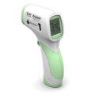
Celsius to Fahrenheit Temperature Conversion Chart
This is shown above
In the event temperatures are required
34.0 C to 37.3 C = 93.2 F to 99.14 F – LCD screen will be Green and pass
37.4 C to 37.9 C = 99.32 F to 100.22 F – LCD is Yellow and still allowed under CDC Guidelines
38.0 C to 42.9C = 100.4 F to 109.22 F – LCD is RED, they are not to enter the building or be allowed to stay.
Notes:
This is a chart that converts Celsius into Fahrenheit as all of our thermometers read in Celsius.

Slide 10


PEOPLE FLOW
Before coming to the workplace each day, please pay attention to how you are feeling. Your safety and the safety of those around you depends on a personal self-assessment and self-reporting of any symptoms. If you are sick – Stay home
General Screening Questions for All Persons:
Do you currently have fever, chills, cough, shortness of breath or difficulty breathing, headache, sore throat, muscle/joint aches, loss of taste or smell? If you feel sick, stay home. If you are any of the following
  In the past 48 hours, have you experienced a fever of 100.4 F or higher?
  2. Have you had close unprotected contact with or cared for someone while unprotected diagnosed with COVID-19 in the last 10 days?
  Have you traveled internationally 14 days?
  If a person answers YES to questions 1 send the person home and exclude from work immediately. The person should self-isolate/self quarantine at home for 5 days and wear a face covering for an additional 5 days upon returning. This must be reported to the supervisor. If they answer yes to number 2, ask if they have been fully vaccinated and boostered. Per CDC if they are fully vaccinated with booster, they may come to work, however they should wear a face covering for 10 days. If not vaccinated, they are to quarantine for 5 days, then wear a face covering for an additional 5 days. It is also recommended that both cases be tested after 5 days per CDC. Contact the Director of Safety on any persons that answer yes to any questions.
  If symptoms are present and they are fully vaccinated with booster, they may work, but must wear a face covering for 10 days. If they have had a fever, they must have 3 days without fever and improvement in respiratory symptoms.
  If a person is suspected of COVID, the person must obtain a COVID-19 test and remain home on PTO 5 days or until they receive the results.
Notes:
Again there will be training for all staff on how to implement and use the clear pass app

Slide 11
SITE ENTRY ALL OTHER TIMES
1. PEOPLE FLOW
Will be set by the site manager as to which entrances and exits are to be used
2. NON-EMPLOYEE ACCESS
Will be designated by location manager. Each non-employee will be required to check and sign prior to access to the facility
3. NO SCREENING IS REQUIRED POST PANDEMIC
Temperature or health question screening is not required at this time but could be reimplemented should need arise

Slide 12


Personal Protective Equipment (PPE) During COVID or other pandemics
All other times, PPE needed for task being performed
Masks (Face coverings)PPE for ALL Staff, Persons Served and Hourly Employees agency wide. This will include Administration, Services Coordinators, etc. whenever leaving their office, or having anyone in their office.
Face Coverings are required at New Horizons
Face Shields – Can be worn along with mask if wished
Gloves – Medical grade gloves are to be worn by all those performing disinfection of common surfaces, providing personal care assistance, meal prep and feeding assistance, first aid treatment and dispensing of medication.
After wearing gloves, make sure to wash hands thoroughly immediately after removal of gloves, use proper method for removing gloves.
https://www.cdc.gov/vhf/ebola/pdf/poster-how-to-remove-gloves.pdf
Notes:
Again, this link will take you to a resource on how to safely put on and take off your face covering
The last link here is a resource on how to properly take off your gloves.

Slide 13

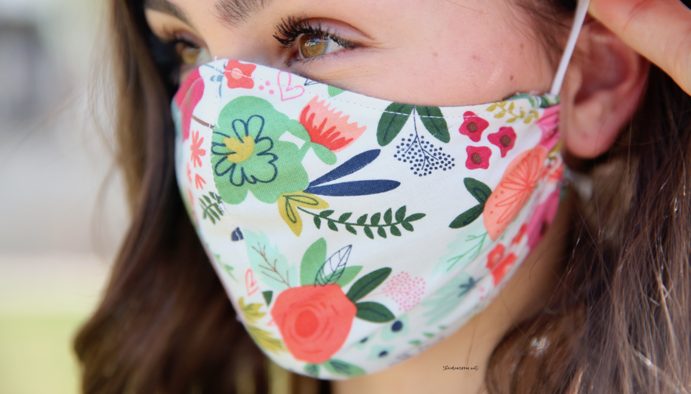


Face Covers
Are optional currently inside New Horizons
Face coverings are optional based on the latest recommendations from the CDC: However, they are still required at New Horizons during transport in agency vehicles.
New Horizons will provide a face covering to each person who needs one.
  If you have your own face covering that you would like to continue to wear because it has a pattern printed on it, it must FIRST be approved by the location Manager.
Notes:
The following is from the CDC and it’s recommendations of wearing a face mask as well as making your own face mask.
* You will not be allowed to wear face coverings with skulls, clown faces etc that is in poor taste or may frighten our individuals.

Slide 14
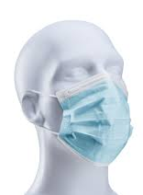
Face Covers Continued
HOW TO WEAR A FACE COVER SHOULD YOU STILL PREFER
Wash or sanitize hands before handling face cover or touching your face.
Put your fingers through the ear loops and position the covering over your nose and mouth
Place the ear loops around your ears or tie if tie style
Adjust to cover both the mouth and the nose
WHAT TO DO WITH YOUR FACE COVER AFTER WORK
Once you have exited the facility and are physically distant from others it is safe to remove your face cover. Store any cloth face covering in a paper bag (not plastic). This will allow the material to dry and protect others.
HOW TO WASH YOUR CLOTH FACE COVER
Hand wash with mild detergent and water. Line dry and reuse the following workday.
Notes:
Link on how to safely wear and take off your face cover

Slide 15
Pandemic Response Team
The Pandemic Response Team is a cross functional team lead by the Director of Safety
Manager – Site manager has overall responsibility for the site’s pandemic preparedness & response plan, coordinating and aligning with Administration, Human Resources and Safety. Works to manage all pandemic related communications with HR and Safety
Access Control Lead – Lead by Site Manager, working with their location team regarding social distancing and coordinating arriving and departing times, as well as visitors.
Virus Prevention & Protocols Lead – Works to develop protocols to ensure the wellness of everyone, and the overall pandemic preparedness and response plan. This should be assigned to Med Control person to oversee at each location.
Sanitation & Disinfection Lead – This is lead by the foreman who will work to manage daily periodic disinfection logistics, including routine and deep cleaning, disinfection processes, in accord to the protocols set up by the Virus Prevention & Protocol Lead.
PPE & Materials Lead – Works to secure all necessary supplies to implement and sustain the sites pandemic preparedness plan. At the branch locations, this will be the foreman. At the office locations, this will be assigned by location manager.
Communications & Training Lead – Managers with the support of the Public Relations Department, will be responsible to ensure staff are staying up to date on any additional training and communication, through email, NH Communication SharePoint information page and on our website.

Slide 16
Post Pandemic Emergency Response
Manager – Site manager has overall responsibility for the site’s Emergency Response while coordinating and aligning with Administration, Human Resources and Safety. Works to manage all emergency related communications with HR and Safety
Access Control Lead – Lead by Site Manager, working with their location team regarding limiting of persons allowed access during an emergency response, coordinating arriving and departing times, as well as visitors.
Sanitation & Disinfection Lead – This is lead by the designee who will work to manage daily routine and cleaning, disinfection processes, in accord to the protocols set by normal daily janitorial procedures
PPE & Materials Lead – Works to secure all necessary supplies to implement and sustain the sites based on the emergency and daily janitorial cleaning needs. At the branch locations, this will be the designee of the manager. At the office locations, this will be assigned by location manager.
Communications & Training Lead – Managers with the support of the HR and Safety, will be responsible to ensure staff are staying up to date on any additional training and communication, through email, NH Communication SharePoint information page and on our website
NOTE: All New Horizons Staff are required to be trained if in CPR,AED, First Aid, Control the Bleed, assisting with Epi Injector and Inhaler and may provide assistances based on level and certification of training.

Slide 17

Preventative Material Inventory
Mask (Face Coverings)
Medical Grade gloves
Touchless thermometer
Disinfectant Spray/wipes
Spray bottles
Hand Sanitizer
Hand soap
Paper towels
Glasses/face shields
Min. 45-day supply if disposable, minimum 2 each if cloth
Min. 60-day supply
1 at each office location, 1 each admin, 4 each workshops
10% bleach solution or disinfectant spray – 45-day supply
1-liter or 32 oz plastic spray containers
Min. 45-day supply
Min. 45-day supply
Min. 45-day supply
Min. 45-day supply

Slide 18
Disinfection Frequency
Area/Place/Content
Disinfectant/frequency
Common surfaces – door handles, light switches, counter tops
Offices, desk, conference rooms
General objects often used, faucets, sinks, bathroom
Vending machines, lunchrooms, or where eating takes place
Forklifts – wheel, levers, seat
Transport vehicles – seats, seat belts, door and window controls, grab bars
All floors
Manager or designee will set schedule at the branches
This should be part of everyday housekeeping all the time.
10% bleach water or disinfectant – recommended several times daily and at close of day
Disinfectant - end of each meeting and end of day
10% bleach water or disinfectant – Several time daily
10% bleach water or disinfectant – minimum 3 times a day, after each break and lunch
After each use
All surfaces should be cleaned after each use by driver.
Mopped twice daily
Staff will be required to clean their workspace before and after their shift and may also be assigned to clean other areas.
Notes:
This link is a resource from the CDC on How to Clean and Disinfect and how to mix a bleach solution.
Although we are keeping the Vending machines, they will not be in use.
No food trucks for those locations that have it.
No Communal Coffee, as it is a huge touch point that many have contact with. Bring your own coffee from home.

Slide 19
Deep-Cleaning and Disinfection Protocol
The General Disinfection Measures should be followed regularly, whereas the Deep-Cleaning and Disinfection Protocol is triggered when a person is identified as being sick or tested positive for COVID
Deep cleaning should be performed for presumed cases of sickness evident by vomit or diarrhea, or as soon after the confirmation of a positive test as possible.
The scope of deep cleaning is to be the full site, not just the area near the person who may have a positive test.
Notwithstanding, if an active person is confirmed to have COVID positive test, site must inform the VP, HR and Director of Safety, who will make the decision on additional action to be taken based on best recommended practices, followed by site personnel performing a comprehensive disinfection of all common surfaces.
The location manager or designee and Pandemic Team (CERT team) must coordinate the cleaning and disinfection process. They must ensure that:
  There is a specific plan and strategy to clean all site equipment, common areas, and any typical areas
  Only authorized people can access the site during the cleaning and are using required PPE
  Assure that employees are made aware that the work areas have been disinfected through the use of signage

Slide 20
General Disinfection measures Checklist
____ The cleaning crew/employees receive training about the disinfection method and frequency
____ 10% bleach water or disinfectant used appropriately
____ The team conducts a comprehensive cleaning in all common surfaces (sewing machines, forklifts)
____ The team conducts a comprehensive cleaning in all offices, desk and conference room (cabinets, desk, table and chair surfaces)
____ The team conducts a comprehensive cleaning in all general objects often used or touched (doors, windows, handles, faucets, sinks, bathrooms)
____ The team conducts a comprehensive cleaning in lunchrooms or eating surfaces (tables, vending machines, etc.)
____ The team conducts a comprehensive cleaning in all common surface of transportation vehicles (Seat surfaces, hails, belts, door, windows, floor)
____ The team conducts a comprehensive cleaning of floors, walls and multiuse areas
Notes:
Tom P. will be meeting with Foremen to train them in proper cleaning protocols. The foremen will put together the branch cleaning team, schedule and protocols and use this checklist to ensure proper cleaning protocols are being followed.

Slide 21

Van drivers and those using their personal vehicle must follow the New Horizons Rehabilitation Services, Inc. Protocols
All surfaces, seats, dashboards, door handles, seatbelts, etc., must be wiped down with a disinfectant solution daily
Supply of antibacterial gel/hand sanitizer for persons to use upon boarding the van and as needed
Masks will be required for the driver until lifted by Director of Safety
The use of masks by passengers is required until lifted by Director of Safety
Employees who are not feeling well should inform their manager and as has been mentioned, if you are sick from anything, STAY HOME!

Slide 22
Isolation Protocol
Isolation Protocol for all persons who become ill at work:
Advise everyone that if a person feels ill, or if someone observes that another person is exhibiting symptoms of any illness at work, they are to contact the Services Coordinator if a person served, the Foreman or Branch Manager if Staff or an Hourly Employee.
If the Services Coordinator, Foreman or Branch Manager is contacted by anyone with a suspected infection, they must ask the person to go directly home or to the designated Isolation Room.
Isolation Room to be determined by Branch Manger
In the community, isolated the person to the extend possible and contact Services Coordinator or Manager.
Contact the home to pick the person up at the location immediately.

Slide 23
Isolation Procedures
Once the suspected ill person is put in Isolation, immediately contact the home if a person served, if an hourly person or staff, they are to be sent home immediately.
Anyone working with a suspected ill person, must have on gloves and mask.
The Services Coordinator, Foreman or Manager, should do the following:
  Ensure that in all cases, the isolation area and work area is thoroughly cleaned and disinfected, in addition to all other common surfaces recently touched by the suspected infected person. All persons doing this cleaning must wear medical grade gloves and mask.

Slide 24

Isolation protocols for community
Should a person served start showing symptoms of any illness in the community, the following are procedures for the staff.
Contact the Service Coordinator to see if the person can be picked up from the site and have them stay isolated someplace until the home arrives.
Depending on location and if there is staff or guardian at the home, the staff may drop them off at the home
If they need to be transported back to the location to be picked up, keep them as far away in the vehicle as possible from others and be sure ALL are wearing a face covering.
Inform the point of contact at the location so they may implement their cleaning procedures.

Slide 25
Isolation protocols for community – continued
When back at the facility, if possible, keep them isolated in the van until the home arrives. If they must enter, take the shortest way to the isolation area in the facility.
Once the person is out of the van, it must be sanitized completely
If the person had come into the facility, all areas should be cleaned and sanitized again, even if they had just been done.
If a staff starts to show illness symptoms, contact the Services Coordinator, Manager or Foreman, so arrangements can be made to possibly pick up the persons served from the site, have the staff drive the van back to the location. They are to drop the keys at the door and head to their vehicle and leave.
All persons not showing symptoms when returning would go directly to wash hands etc.

Slide 26
PROCEDURES FOR SEP AND COMMUNITY WORK SITES
All staff and persons served at any SEP or community work site must adhere to all New Horizons safety protocols, along with those of the employer.
Proper PPE should be kept with staff at all sites
New Horizons nor any of its staff, may dictate to a company or employer what procedures they should have, so if the employer does not have any in place, we are still to follow those of New Horizons.

Slide 27
REMOTE or HYBRID WORKING
There are no positions within New Horizons Rehabilitation Services, Inc. that can be 100% remote work from home due to needing availability to files or various other items that are located only in the buildings or may be protected under HIPPA or Person Served Privacy. However, remote or hybrid working is permitted for several positions if approved by supervisor. They include the following
President/CEO
VP
Director of HR
All Accounting Staff
Marketing Manager
Director of Public Relations
Director of Manufacturing
Director of Safety
Information Systems Manager
Location Managers
Services Coordinators based on direction of their manager
Job Development and Placement Staff based on direction of their manager

Slide 28
COVID OR ANY ILLNESS CASE FORM
This information is to be sent to HR and Safety
Is this a person served, staff, or hourly employee: ___________________
Date: _______________
Location: ____________________________________ (i.e., community, SEP, inhouse, etc.)
Did person show symptoms: Yes _______ No _______
Last date of contact: ____________________
Was person tested: __________________
Date of test: __________________
Results of test: ___________________
DETAILS OF REPORTER
Name: _____________________ Title: ____________________
Notes:
This form needs to be filled on anyone showing symptoms and reported immediately to HR (Jason), VP (Kim) and Safety director. (Steve)

Slide 29


Physical (Social) Distancing and Ventilation during COVID or other outbreaks
Physical distancing, also called “social distancing,” is the act of keeping space between yourself and other people outside of your home. This, in combination with minimizing touchpoints and increasing airflow, is crucial in preventing the spread of ILLNESS
Staying 6 feet away from others as much as possible.
Eliminating contact with others, such as handshakes, fist bumps or embracing (hugging) others is optional but encouraged based on comfort level
Avoiding touching surfaces touched by others that have not been cleaned, to the extent feasible
Avoiding anyone who appears to be sick, or who is coughing or sneezing for any reason
Managing ventilation to decrease the risk
Fans to move air around the shop, NOTE: The fans are NOT to be blowing directly on people, but only to move air around.
This practice of physical distancing is recommended with illness or suspected illness, or based on comfort level

Slide 30

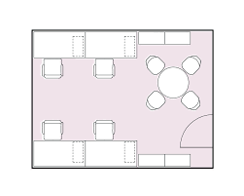
Social Distancing in Manufacturing during COVID
Social Distancing in Manufacturing is intended to provide a safe environment reducing risk of any potential person – to – person infection
At present New Horizons no longer has requirements for distancing based on CDC, MDHHS and OCHD direction. However, if needed, these may be reimplemented at any time as needed by the Director of Safety
Recommended
Whenever possible, workstations should be arranged to allow separation of 3 feet
Clear signage about the desired position of the person may be placed in each workstation
Utilize production transfer aids (such as push boards to move work to another person) to minimize the risk to distancing
Workers are to disinfect their own workspace several times during the day. Staff are to disinfect the work area of persons served several times during the day.
Remind everyone often to avoid touching their faces. Everyone must wash their hands with soap and water for a minimum of 20 seconds several times during the day to reduce risk of any type of illness
What to do if the workstations are less than the recommended spacing?
If 3 feet between workstations is not possible, try to maintain as much distance as possible
Shift body orientation to avoid any face-to-face operations

Slide 31

Social Distancing During Arrival and Departure
At present New Horizons no longer has requirements for distancing based on CDC, MDHHS and OCHD direction. However, if needed, these may be reimplemented at any time as needed by the Director of Safety
Have all persons maintain 6 feet apart upon arrival if possible while waiting for screening. After screening, they are to go immediately and wash their hands. NOTE: Everyone should have on a mask
  Screening will include a series of questions
  The taking of temperature.
  Failure of passing any of the questions or a temperature, may result in being sent home
  After screening, have persons go wash their hands or use hand sanitizer before clocking in and/or going to their work area.
Do not allow vans to unload until their scheduled arrival time.
Stagger departure times to the extent possible to avoid people gathering at the door to leave. Have everyone remain at their area until their van arrives to pick them up. Only allow one van of persons to leave at a time, to avoid backup at the door.
Stagger pickup times to allow time for paperwork to be completed and areas to be cleaned and sanitized.

Slide 32
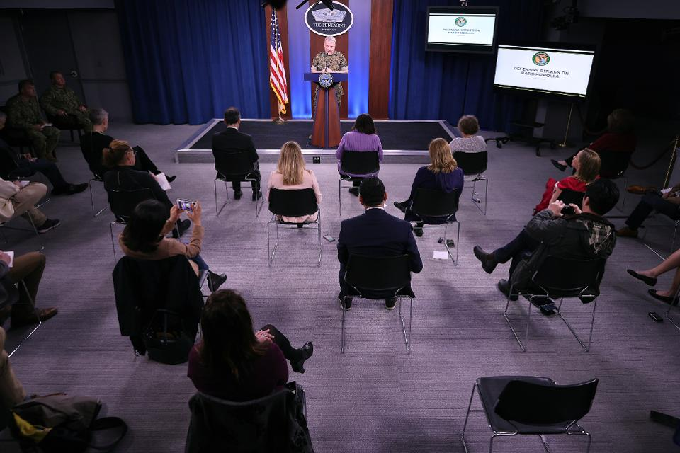
Shop Floor and/or Office Meetings
At present there are no longer restrictions on meetings, however these may be reimplemented at any time as needed by Director of Safety
Social Distancing During Breaks as much as possible
If need be, stagger times to maintain distancing while on break and lunch
Separate times by 10 minutes to allow for each table, seat, all surfaces, vending machines and microwave to be wiped down
Place signage on tables if needed to ensure proper distancing
Everyone must wash hands prior to and immediately after break
Station 1 or 2 staff to observe and make sure distancing is being followed
For locations with a small break room, maintain 6 feet apart, if possible, for those who use that room for break and lunch, stagger breaks and lunch for those people if needed.
For locations with Food trucks, have floor marked and laid out to only allow one or two people maximum at the truck at one time NOTE: For the time being food trucks will be suspended.
Station 1 staff to monitor the outside smoking areas, to insure distancing
Increase cleaning intervals to ensure bathroom is clean
Notes:
*Depending on the number of persons and square footage, foreman and branch managers may need to stagger break and lunch times.

Slide 33
Visitors, Vendors or Contractors
It is recommended to avoid having Vendors and Contractors into any facility if possible. If a Contractor i.e. Allied for a plumbing issue, the worker entering MUST check-in
All visitors such as Service Coordinators from funding sources, should make appointments if possible and check-in upon arrival
ALL essential visitors (i.e. APS, Recipient Rights etc.) should request a date and time to visit and it must be approved by Site Manager.

Slide 34
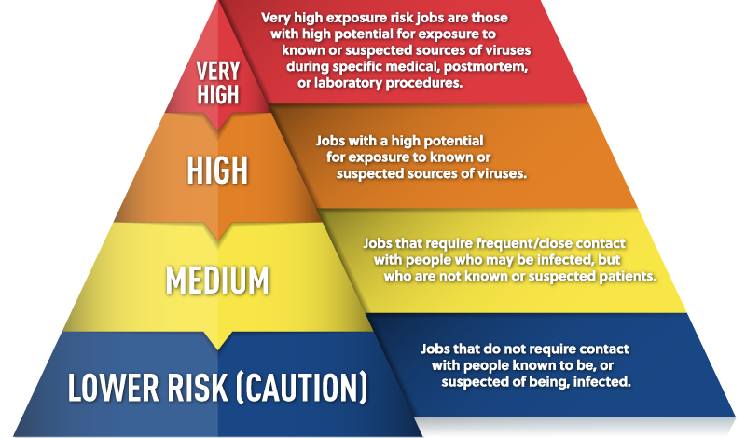
In most cases New Horizons is a Low to Medium Risk for COVID
Notes:
This slide show a chart that categorizes the level of risk a company may fall into. New Horizons falls into a Low to Medium risk category.

Slide 35
SITES TO OBTAIN ADDITIONAL INFORMATION ON COVID 19 and protection
RECOMMENDED
https://www.michigan.gov/coronavirus/
https://www.cdc.gov/coronavirus/2019-ncov/index.html
HIGHLY RECOMMENDED
https://www.vaccines.gov/
For a list of places to obtain a vaccine
Notes:
The first resource is mandatory that all staff read and sign off on. Below that are additional resources on COVID 19

Slide 36
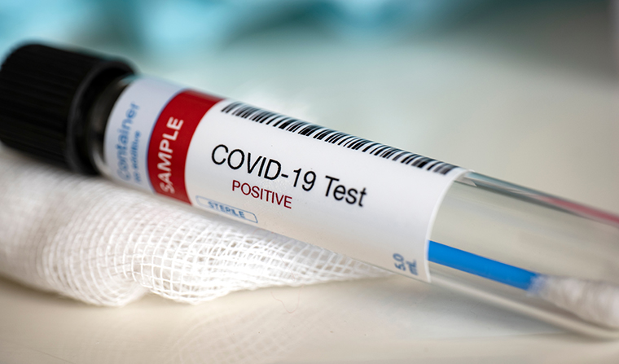
COVID TESTING SITES
https://www.oakgov.com/covid/best-practices/sick-caring/Pages/testing.aspx
https://springfieldurgentcare.com/medical-testing/covid-19-antibody-testing/ Also does the antibody testing

Slide 37
Acknowledgement
I Acknowledge that I have read and understood all of the information in the Safe Work Playbook and will follow all the requirements.
I understand that any updates or changes to this protocol will be placed on SharePoint, an agency email will inform me of changes made and that I must go into SharePoint and read the updates and changes and follow those requirements.
Print Name: _______________________________________
Date: ____________________________________
Location: __________________________________
Signature: ______________________________________
Notes:
All staff must log into SW to sign this form. Do so ASAP, as your login expires from 90 days of last login.

Slide 38
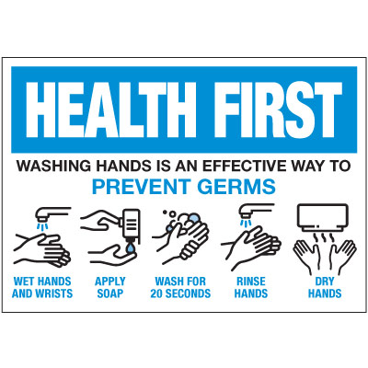
HAND WASHING WORKS, DO IT OFTEN

Slide 39

Mental Health and Wellness Resources
https://youtu.be/CL95EsnLFuo (self-care video for DSPs)
https://youtu.be/_eeqEiZ-pxc (mediation for DSPs in times of stress)
https://emergency.cdc.gov/coping/index.asp (Coping with a disaster or traumatic event)

Slide 40
Questions or Comments
Please email all questions and comments concerning COVID to this email:
All other general safety questions:
jferrell@newhorizonsrehab.org
Director of Safety
jkaszubski@newhorizonsrehab.org
Director of Human Resources
COVID19@newhorizonsrehab.org

Slide 41
General Health and Safety Rules
The rules in this Safe Work Guide we are using do not negate all other Health and Safety procedures that have been presented at time of hire along with annual trainings and drills that cover the following. These trainings and drills remain in effect and are to continue to be followed. They are also in Share Point for review at any time.
General Safety Regulations
Emergency Evacuation to Back up Shelter (Branch / Office Locations)
Fire Drill Procedures
Weather Drill Procedures
Exposure Control Plan for Bloodborne Pathogens
Safety Training Plan
Critical Incident
Facility Safety Inspection Checklist
Policy on Violence & Aggression
CPR/AED/First Aid – bi-annually every two years

